Slide 1
Assalam-o-alaikum

Slide 2

OPERATING SYSTEMS
LAB TASK 1
Shaheed Zulfikar Ali Bhutto Institute of Science & Technology
COMPUTER SCIENCE DEPARTMENT
Name: Waseeq Ur Rehman
Reg #: 2180245
Section : BSSE 4”A”
Project submitted to : Sheikh Badar Ud Din Tahir

Slide 3
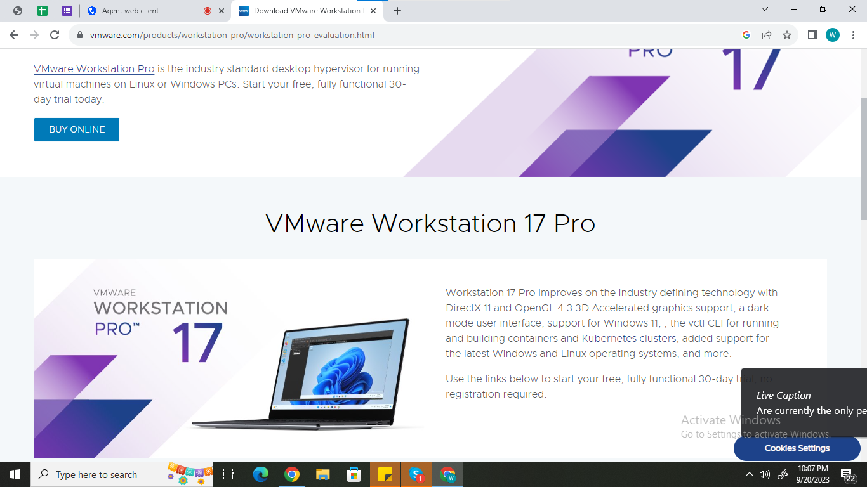
VM WARE WORKSATATION
Shaheed Zulfikar Ali Bhutto Institute of Science & Technology
COMPUTER SCIENCE DEPARTMENT

Slide 4
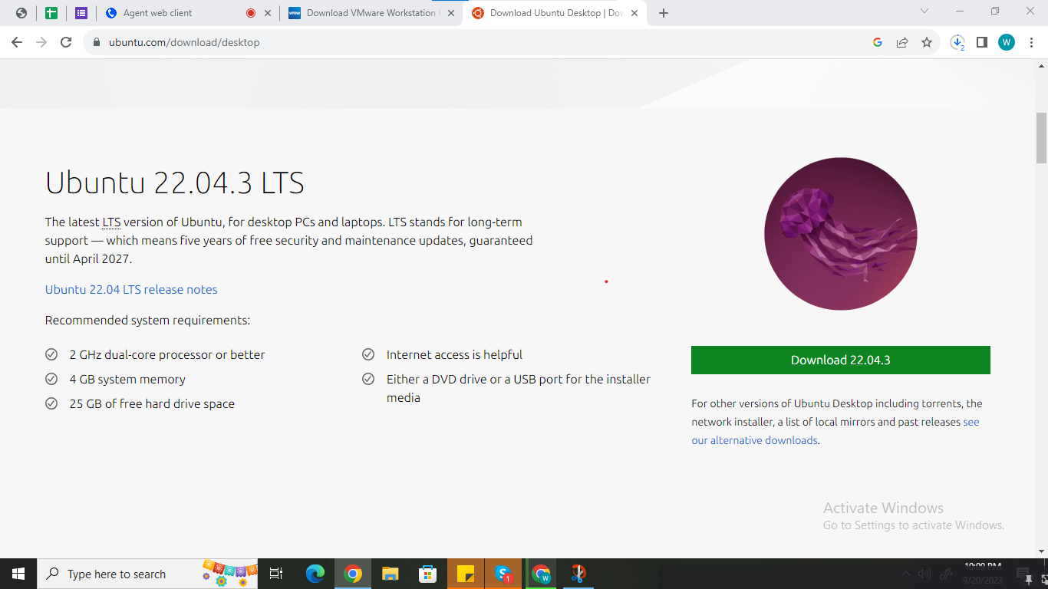
Ubuntu Downloading platform
Shaheed Zulfikar Ali Bhutto Institute of Science & Technology

Slide 5
Thank you

